Slide 1
Medium Earth Orbit Satellite
BY: PRIYANSHU GAUR

Slide 2
In between LEO & GE0
Range: 2000 km to 35870 km
Medium Earth Orbit is also known as intermediate circular orbit (ICO).
INTRO

Slide 3
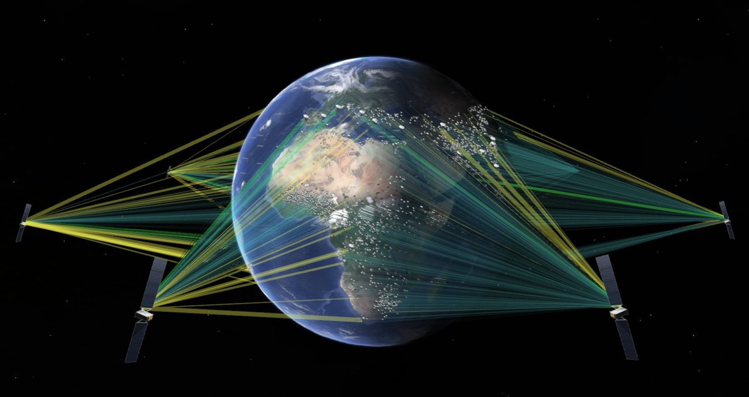
Orbital Period
About 2 to nearly 24 hours.
Depends upon the distance from the earth
MEO satellite at the altitude of 20200 km have 12 hour time period used in GPS

Slide 4
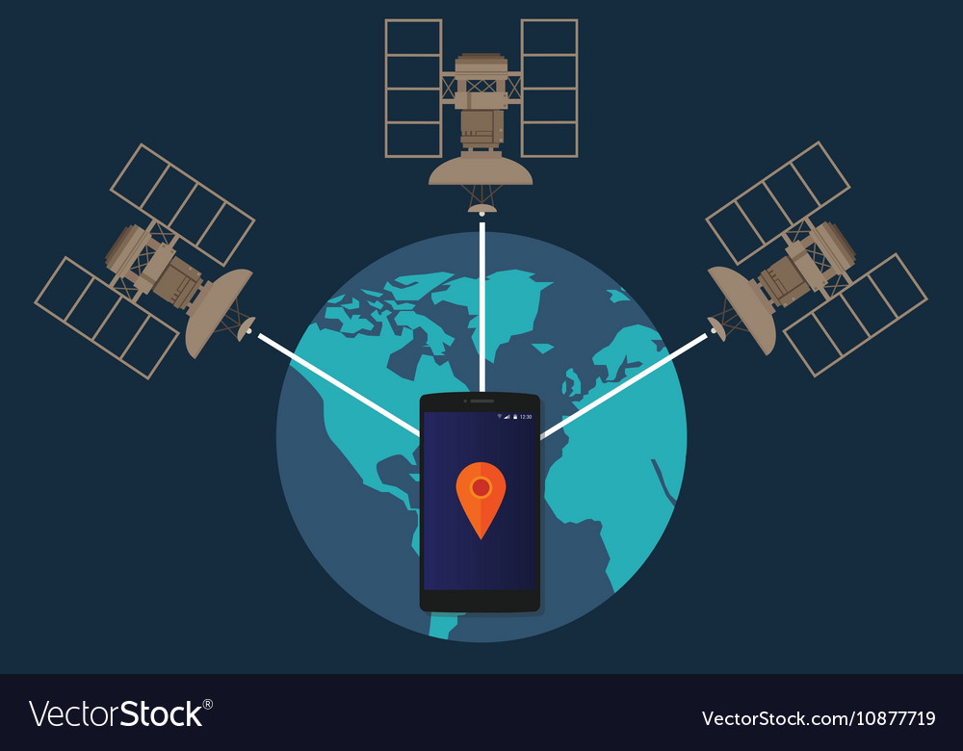
Global Postioning System(GPS)
GPS is the system which can show you your exact position on the earth anytime.
The Global Positioning System consists of 24 satellites, that circle the globe once every 12 hours, to provide worldwide position, time and velocity information. GPS makes it possible to precisely identify locations on the earth by measuring distance from the satellites. GPS allows you to record or create locations from places on the earth and help you navigate to and from those places.

Slide 5
Other Positioning Systems based on MEO.
Russian GLONASS (altitude 19100 km)
European Galileo (altitude 23222 km)
Chinese BeiDou (altitude 21528 km)

Slide 6
Disadvantages of MEO
Signal received from MEO satellites is weaker than LEO’s.
It needs to be tracked.
MEO satellite system is more expensive than LEO satellite system.
They need higher transmission power and faces longer time delays.
Multiple MEO satellites are required to cover a region continuously.
Increases orbital debris because of need of large number of satellites per system.

Slide 7
Advantages
Less onboard fuel for launch vehicle
Less number of satellites than LEO in the constellation for full coverage
They can capture weaker signals than in GEO

Slide 8
Thank You !

